Slide 1
Measuring Climate Change

Slide 2
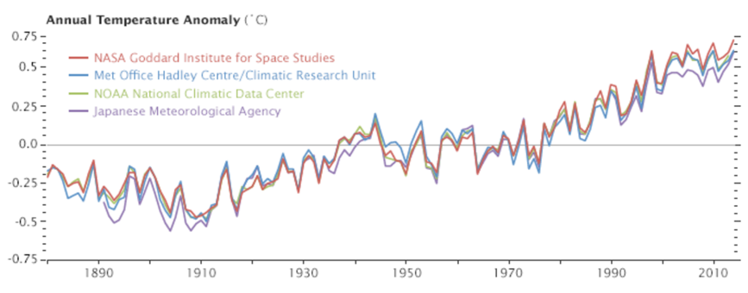
Motivation
How do we measure “globally averaged temperature”?
Impossible to measure temperature at every place on Earth at the same time…..
Take lots of measurements
Try to make sure you are getting some measurements from everywhere
Source: NASA
Notes:
How can we know global temperature is rising without having good knowledge of what global temperature is? What does global temperature even mean? We can’t possibly measure the temperature at every point on the Earth at the same time

Slide 3
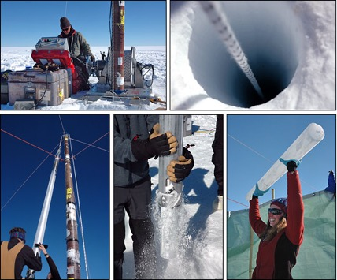
Paleo measurements vs historical
Generally, paleoclimatology refers to measurements before the historical record. This may use ice cores, tree rings, sediment cores, corals, or many other methods. In these cases, we are not directly measuring temperature, instead we are inferring it indirectly from other evidence
Historical (modern) climatology is when we started using instruments to measure climate and writing down the data. Some of this data comes from before the 1700’s, although the vast majority of the data is from the past 10-20 years.
Source: NASA

Slide 4
Key measurements of Climate Change
Globally averaged temperature
Sea surface temperature
Sea level
Many others
Sea ice extent
Snow cover
Precipitation
Salinity
Wind speed

Slide 5
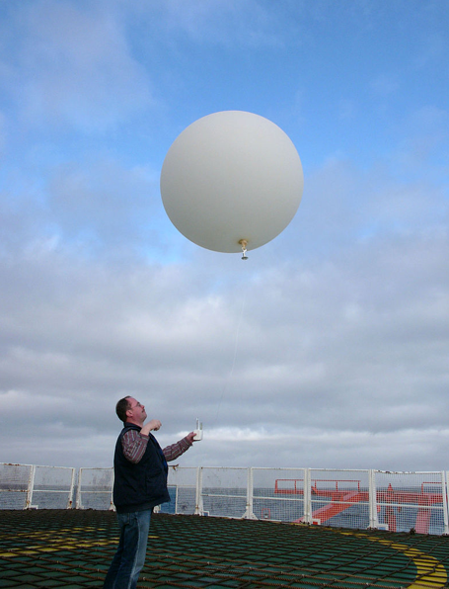
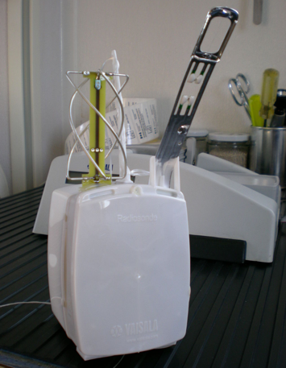
Atmospheric temperature
Radiosondes measure temperature with increasing height
Source: NWS
Notes:
Historical – just measure temperature! Radiosondes carried by weather balloons. Locations from NWS – but may be blurry. Mention how you can also just measure T from the ground but may be impacted, ex in cities will be higher due to lots of asphalt

Slide 6
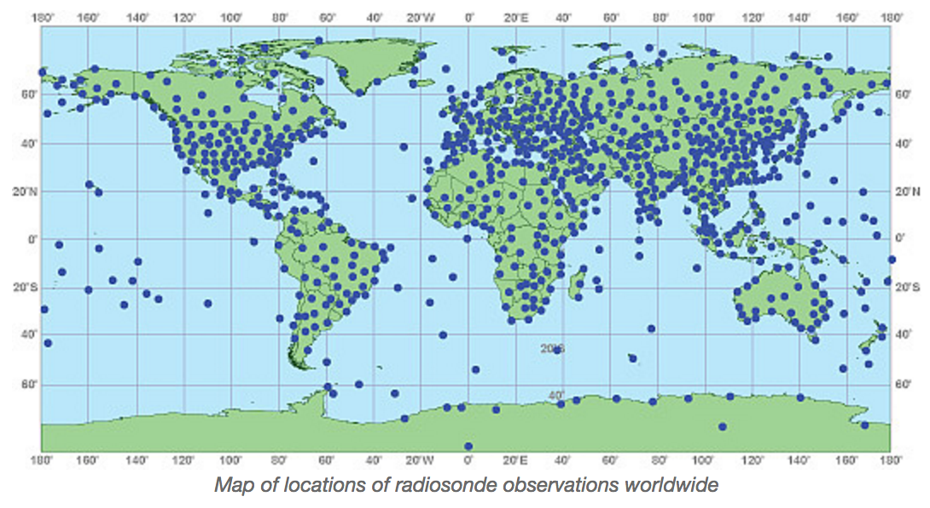
Source: NWS
Notes:
National Weather Service map of regular radiosonde observation locations. In the past – even less. Notice that they are almost all over land, there are more in N Hemisphere, and there are some notable regions with gaps (parts of Africa, Australia, Greenland)

Slide 7
Sea temperature
Notes:
Include pictures of a few instruments –CTD, ARGO floats. Historical – just take temperature from a ship, in bucket (mercury thermom). Picture is from WWII. Next started measuring temperature as water is brought into the ship to cool the engine. Now we use CTD, which is an instrument that is lowered off the side of a ship and can measure T, S, and other values such as nutrients as it is lowered. Show image of ship paths – obviously there are some big areas that we aren’t covering. CTD’s started 1960s, ARGO floats started ~ 2000? Key point: CTDs only where ships go, also preferably in summer. Also talk about engine intake measurements

Slide 8
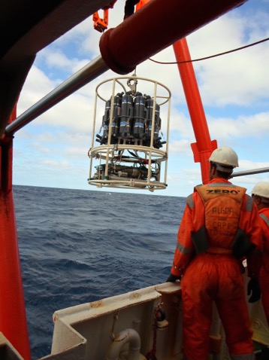
Sea temperature
CTDs (Conductivity-Temperature-Depth) can measure ocean temperature at different depths
Source: WHOI
Notes:
CTDs started mid 1950s. Cord used to send power down to instrument (can trigger bottle firing), bring data up from instrument in real time, and to lower the instrument down. Can be lowered all the way to the ocean bottom if you have enough cable. Really boring in calm seas, really stressful in rough seas. Impossible to sample in bad weather. Can go close to Antarctica but it’s not fun (and v expensive). Bottles can be used to take water samples from different depths and use them to calibrate salinity measurements or investigate chemistry or biology at those depths

Slide 9
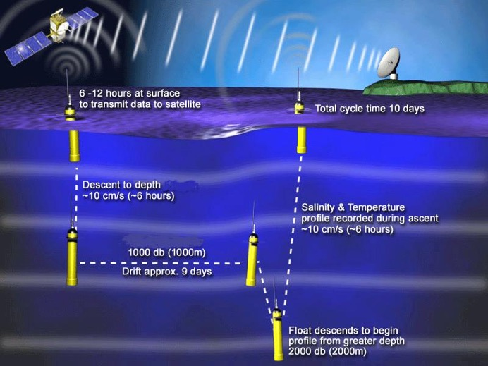
Sea temperature
ARGO floats can measure temperature without the use of ships, allowing for measurements in times and places it may be unsafe to sail (ex: near Antarctica, in storms)
Source: UCSD
Notes:
Starting early 2000s, now there are ~3000 floats at any given time. Allows measurements from times/places that it is difficult to make ship based measurements, for example, in the Southern Ocean, in areas where political issues make it difficult to sample (off Somalia), and in storms/bad weather.

Slide 10
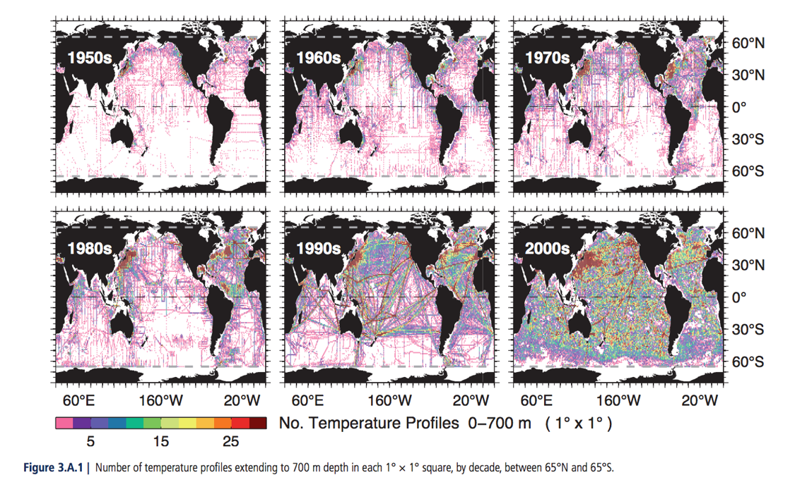
Source: IPCC
Notes:
From IPCC. Used to mainly be temperature measurements in the N hemisphere and along major shipping tracks. As time went on, we get more and more measurements. Now it is more balanced between N and S Hemisphere because of ARGO floats, but there still aren’t many temperature profiles near Antarctica. Point out regions that are sparse vs regions with lots of measurements. Also make point of “fair weather bias”

Slide 11
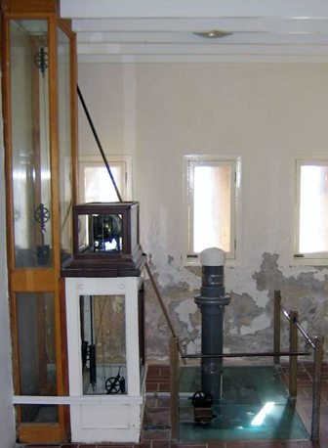
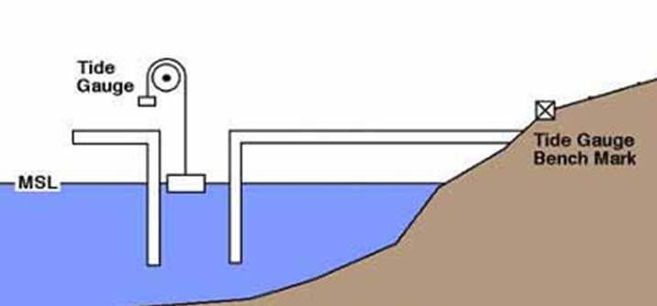
Sea level
Old and new tide gauge (Geodetic Society of Australia)
Notes:
Historical – tide gauge data. Originally put in place to monitor flooding for coastal communities. Really good for local sea level but again, there is not a global coverage (map of historical tide gauges?). Pic may be blurry?? Explain idea of tide gauge – float on the surface of water which moves up and down, then there is a pen which measures that level

Slide 12
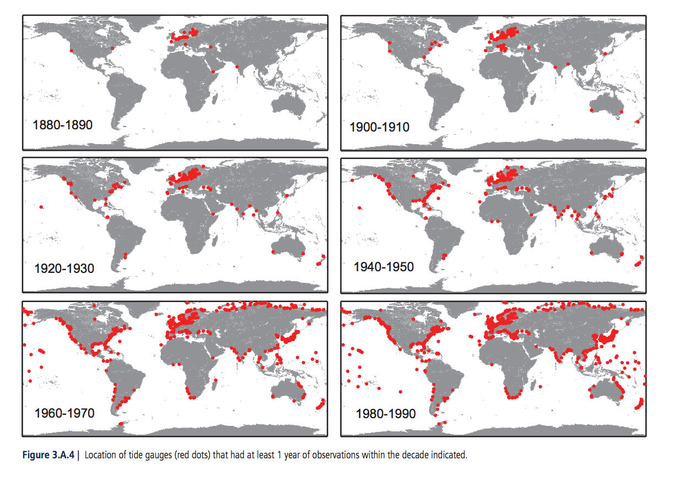
Source: IPCC
Notes:
From IPCC – however some sites have had tide gauges for much longer than others. Ex: 4 sites in N Europe have been monitored since the 1700’s, by late 1800’s there were measurements in N Europe, both N American coasts, Australia, New Zealand (graph up???). Measurements are only at coastal sites, can’t tell what’s happening in the middle of the ocean. Also lacking measurements from large portions of Africa, S America, Australia, Indonesia

Slide 13
Satellite data
https://www.youtube.com/watch?v=93fr-C3R0ys
Notes:
We can also get temperature measurements from satellites. This is much easier in some regions because it means that we don’t have to go out on ships near Antarctica. This gives us a global coverage of temperature. Can get atm temperature, ocean temperature, and sea ice extent (show image of each). Go through TOPEX/Poseidon measurements, starting 1992. Quikscat for sea ice extent (?) AVHRR: advanced very high resolution radiogram.
Video: shows the 16 NASA remote sensing observatories orbiting earth. They make measurements of properties including rainfall, clouds, sea surface height, and ocean salinity. https://www.youtube.com/watch?v=93fr-C3R0ys

Slide 14
Sea surface temperature
Source: NASA
Notes:
Show some data from satellites. This is SST from AVHRR pathfinder

Slide 15
Surface chlorophyll
Source: NASA
Notes:
Surface chlorophyll from NASA – May/June 2006 composite

Slide 16
Surface temperature
Source: NASA
Notes:
Surface temperature – aka the temperature of the top mm of Earth’s land areas, averaged over 9 years (2000-2008)

Slide 17
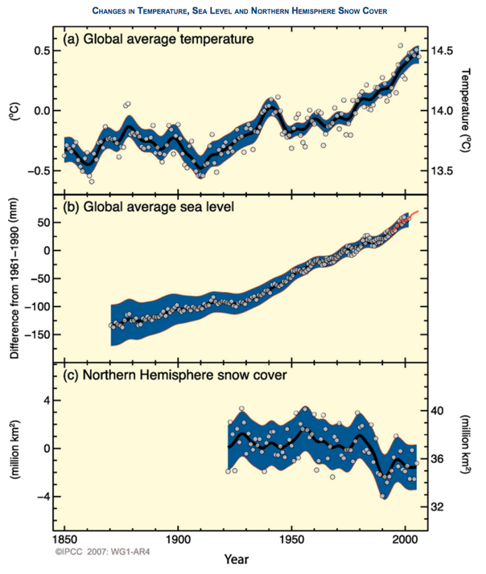
Each dot is actually the combination of thousands of measurements at different locations every day
Different measurements all show a warming trend
We are more confident of more recent values, because we have more data and better global coverage
Source: IPCC
Notes:
Could show – some years are anomalies, possibly due to sampling bias or just year to year fluctuation. We get more sure as time goes on because our measurements have become more global. Lots of measurements of lots of different properties, put together, gives us confidence that warming is occuring

